Slide 1
Idea and Value Creation
Description of Product:
Headlight sensor is an sensor which is used to dim and dip the headlight of the car or any heavy vehicles, so that while travelling in single roads we can easily drive our vehicles.
Problem addressed:
This sensor is useful in automatically dim and dip the car headlight because most of the drivers never give dim when there is an vehicles Infront of them while travelling at night, which cause a huge problem.
Benefit that we are bringing to the world:
As per records the accidents caused at night in single roads is about 20.4% in 2022. The main benefit of using this sensor is to avoid accidents at night time.

Slide 2
Innovation
Innovation in the idea to be highlighted:
The main innovation that is highlighted here is, the headlights using this sensors automatically gets dim and dip as soon as a frequency of 200 – 400 kHz light source which makes better visibility of single roads at dark.
Technology:
The technology used in this project is a LDR(Light Dependent Resistor) sensor which automatically adjust the intensity beam when it finds the vehicle in opposite direction.

Slide 3
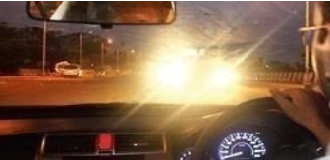
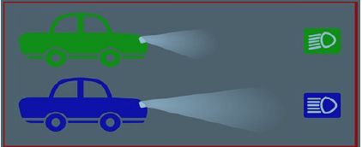
Sketch of Product
Fig:5.1 Fig:5.2

Slide 4
Project Plan
Market Research and Analysis:
Conduct thorough market research to identify potential user base and competition.
Product Development and Testing:
We are in the progress of Designing and developing the sensors to conduct extensive testing.
Launch and Marketing Strategy:
We will implement a comprehensive marketing strategy to reach target users around world.

Slide 5
Market Size / Commercialization Potential
Total Addressable Market (TOM):
108.10 Billion USD
Serviceable Obtainable Market (SOM):
25 Billion USD
Serviceable Available Market (SAM):
10-15 Billion USD

